Slide 1
Gaming Analysis with SQL
Internship Project by Anusiem Adaeze Comfort with Mentorness
BATCH: MIP-DA-06

Slide 2
Table of Contents
About the project
Dataset Description
Outcomes
New Learnings
Analyze SQL problem statements
Conclusion

Slide 3
About the project In this project I worked with a dataset related to a game. The dataset includes two tables: `Player Details` and `Level Details`. Below is a brief description of the dataset
Player Details Table:
`P_ID`: Player ID
`PName`: Player Name
`L1_status`: Level 1 Status
`L2_status`: Level 2 Status
`L1_code`: Systemgenerated Level 1 Code
`L2_code`: Systemgenerated Level 2 Code
Level Details Table:
`P_ID`: Player ID
`Dev_ID`: Device ID
`start_time`: Start Time
`stages_crossed`: Stages Crossed
`level`: Game Level
`difficulty`: Difficulty Level
`kill_count`: Kill Count
`headshots_count`: Headshots Count
`score`: Player Score
`lives_earned`: Extra Lives Earned

Slide 4
Dataset Description
Players play a game divided into 3-levels (L0,L1 and L2)
Each level has 3 difficulty levels (Low,Medium,High)
At each level,players have to kill the opponents using guns/physical fight
Each level has multiple stages at each difficulty level.
A player can only play L1 using its system generated L1_code.
Only players who have played Level1 can possibly play Level2
using its system generated L2_code.
By default a player can play L0.
Each player can login to the game using a Dev_ID.
Players can earn extra lives at each stage in a level.

Slide 5
Outcomes
Gain strong analytical skills
Enhance critical thinking abilities
Enhance excellent communication skills
Sharpen my ability to handle large and big data

Slide 6
New Learnings
Stored Procedures are sets of SQL codes that can be created, stored and accessed often
Ability to use window functions to perform a calculation on an aggregate value based on a set of rows and return multiple rows for each group
How to use SQL Rank function and Row_Number function to find highest and lowest scores based on categories
How to use nested queries in SQL

Slide 7
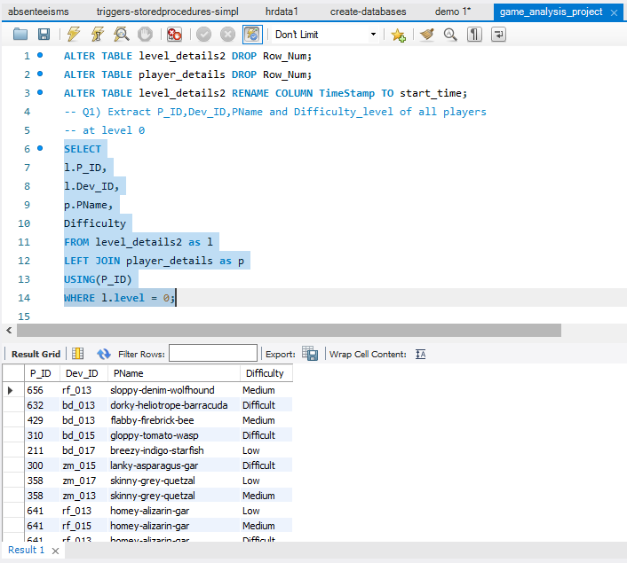
Analyze SQL problem statements 1. Extract `P_ID`, `Dev_ID`, `PName`, and `Difficulty_level` of all players at Level 0.

Slide 8
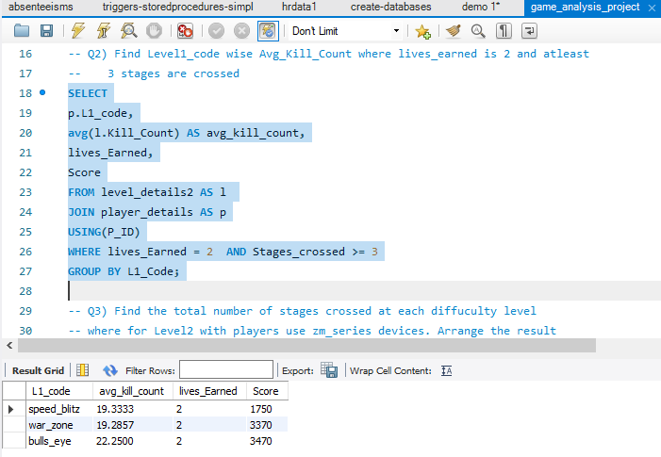
2. Find `Level1_code`wise average `Kill_Count` where `lives_earned` is 2, and at least 3 stages are crossed.

Slide 9
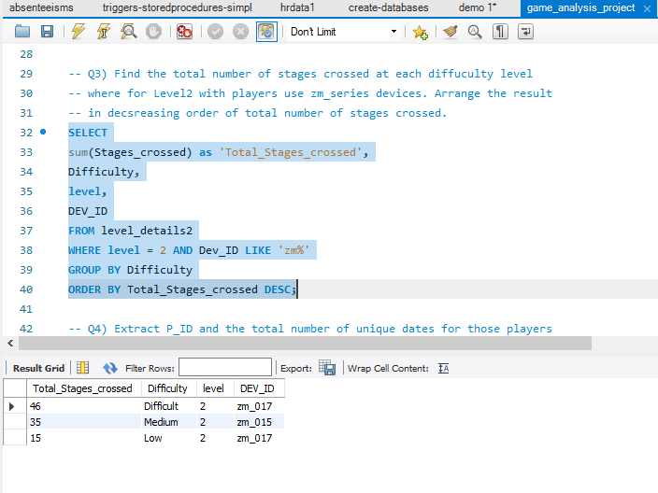
3. Find the total number of stages crossed at each difficulty level for Level 2 with players using `zm_series` devices. Arrange the result in decreasing order of the total number of stages crossed.

Slide 10
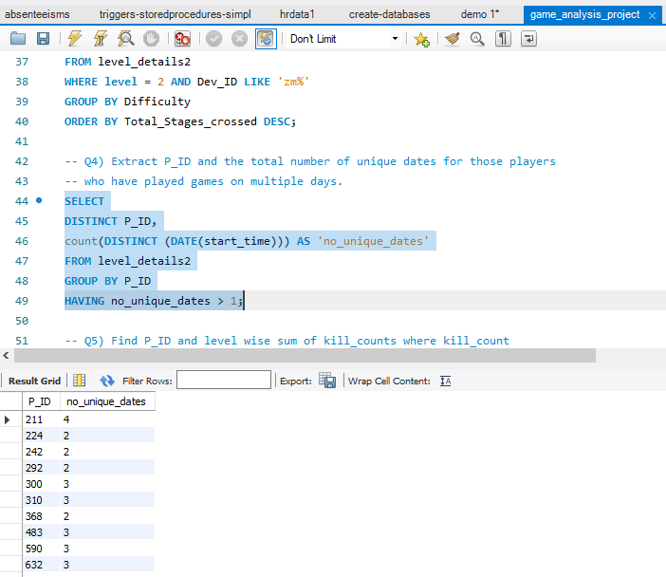
4. Extract `P_ID` and the total number of unique dates for those players who have played games on multiple days.

Slide 11
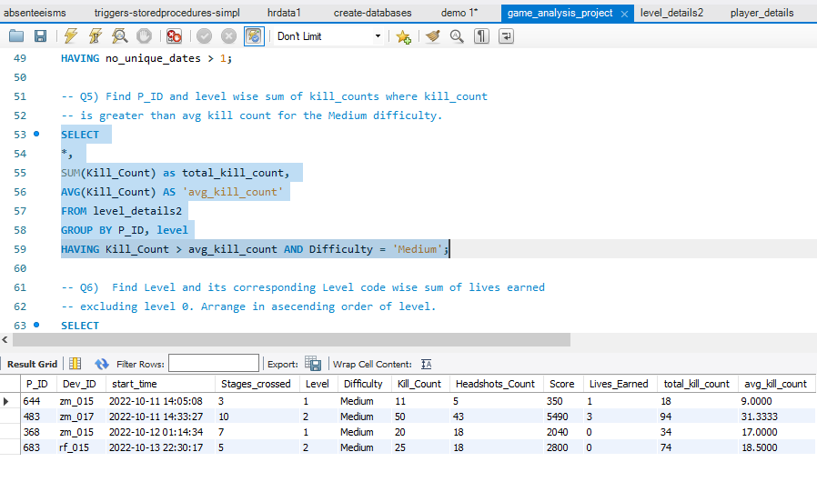
5. Find `P_ID` and levelwise sum of `kill_counts` where `kill_count` is greater than the average kill count for Medium difficulty.

Slide 12
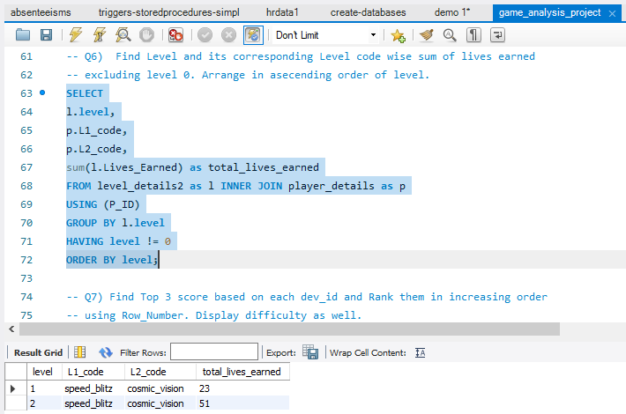
6. Find `Level` and its corresponding `Level_code`wise sum of lives earned, excluding Level 0. Arrange in ascending order of level

Slide 13
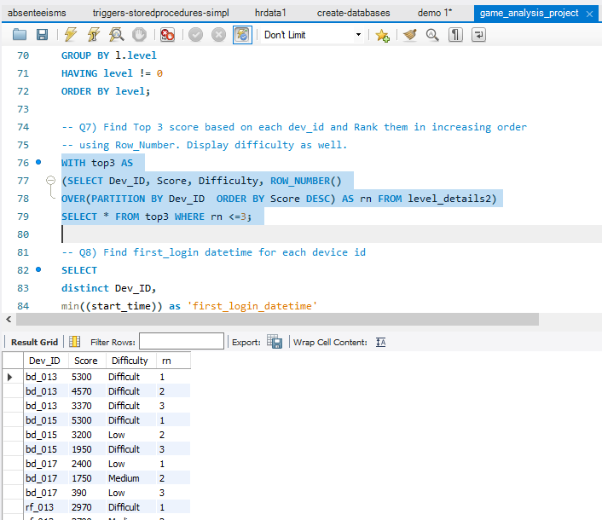
7. Find the top 3 scores based on each `Dev_ID` and rank them in increasing order using `Row_Number`. Display the difficulty as well.

Slide 14
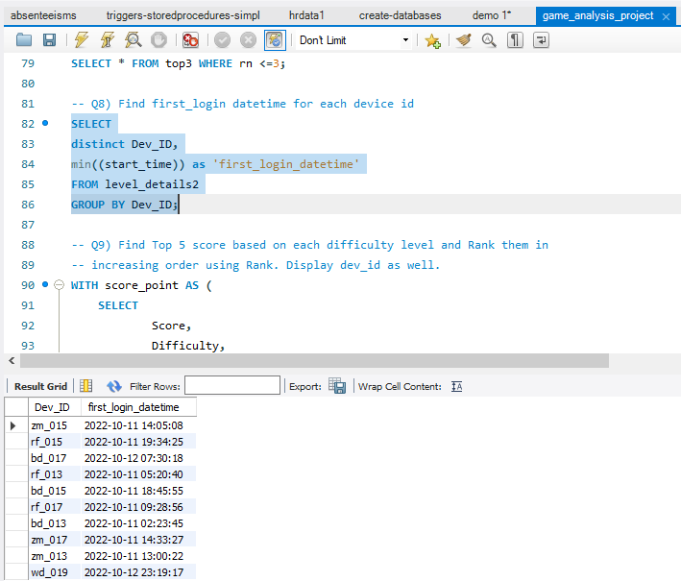
8. Find the `first_login` datetime for each device ID.

Slide 15
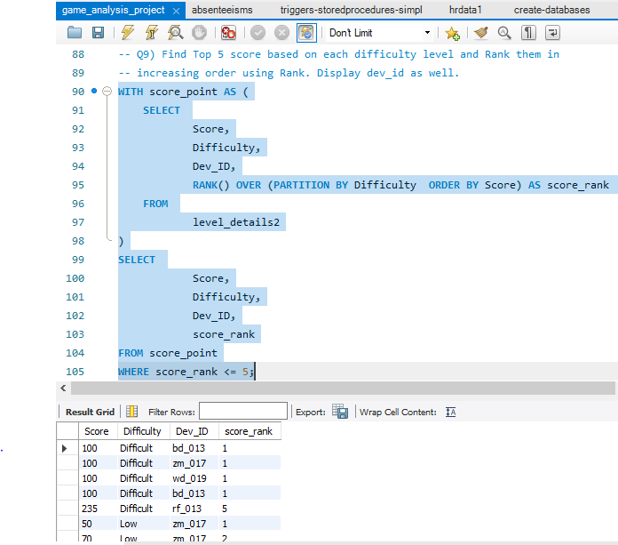
9. Find the top 5 scores based on each difficulty level and rank them in increasing order using `Rank`. Display `Dev_ID` as well.

Slide 16
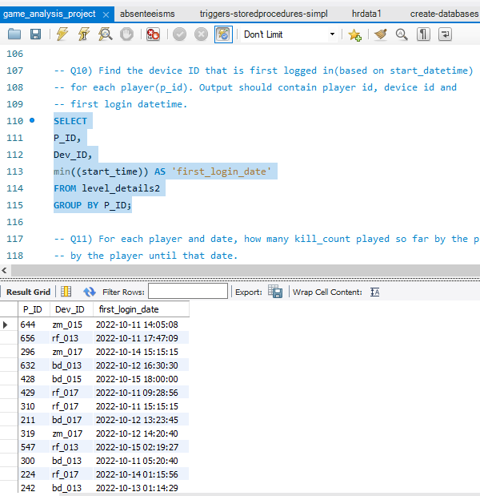
10. Find the device ID that is first logged in (based on `start_datetime`) for each player (`P_ID`). Output should contain player ID, device ID, and first login datetime.

Slide 17
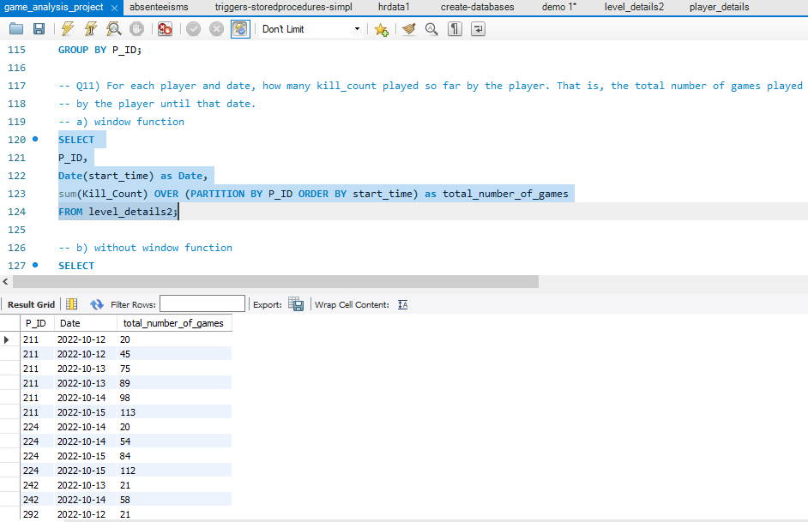
11. For each player and date, determine how many `kill_counts` were played by the player so far. a) Using window functions

Slide 18
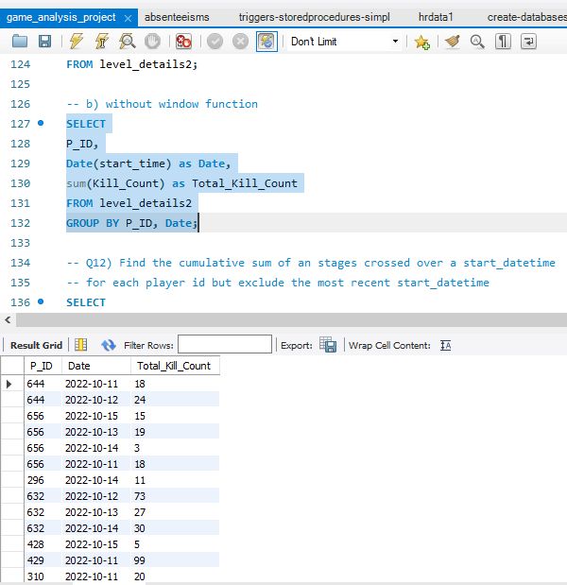
11. For each player and date, determine how many `kill_counts` were played by the player so far. b) Without window functions

Slide 19
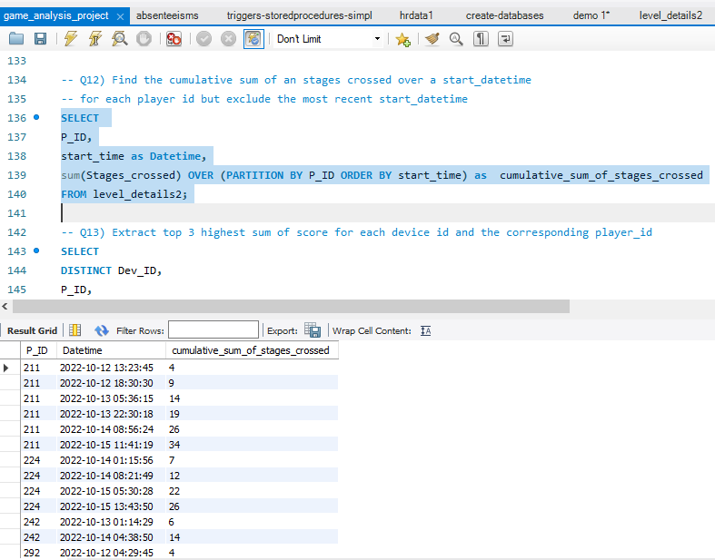
12. Find the cumulative sum of stages crossed over `start_datetime` for each `P_ID`, excluding the most recent `start_datetime`.

Slide 20
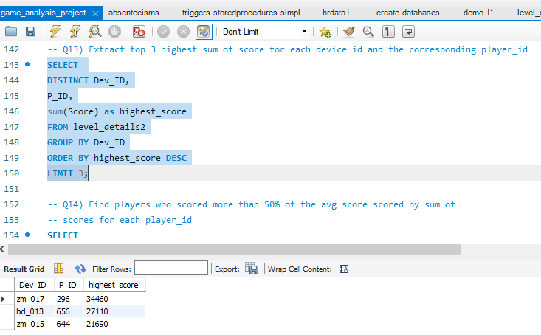
13. Extract the top 3 highest sums of scores for each `Dev_ID` and the corresponding `P_ID`.

Slide 21
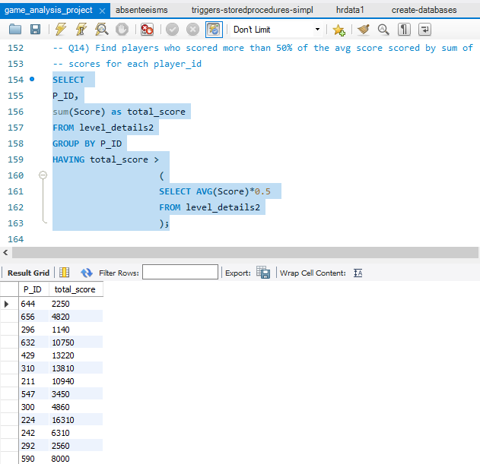
14. Find players who scored more than 50% of the average score, scored by the sum of scores for each `P_ID`.

Slide 22
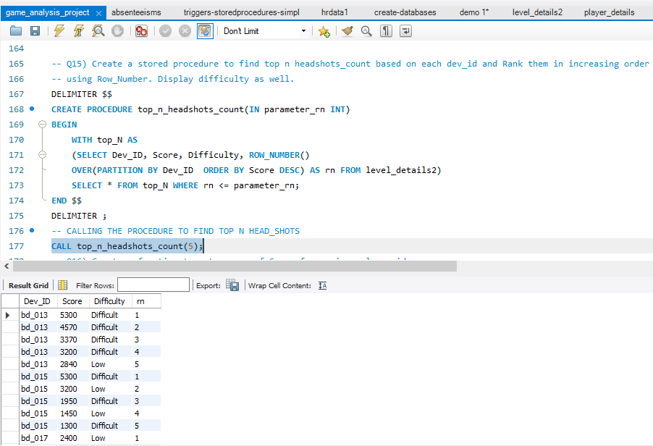
15. Create a stored procedure to find the top `n` `headshots_count` based on each `Dev_ID` and rank them in increasing order using `Row_Number`. Display the difficulty as well.

Slide 23
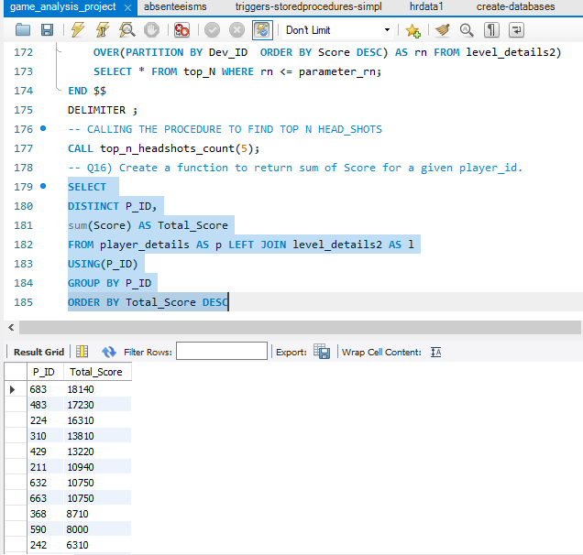
17) Create a function to return sum of Score for a given player_id.

Slide 24
Conclusion
SQL is needed to seamlessly navigate through simple and complex datasets, it is used to efficiently execute queries, edit database tables and extract meaningful insights from a dataset to make decisions.
In this game analysis project, using SQL I was able to solve some statement problems, query necessary data to identify pattern and behaviors of the game, to predict gaming outcomes and scores, identify excellent players and most suitable devices they used and many others.

